Slide 1
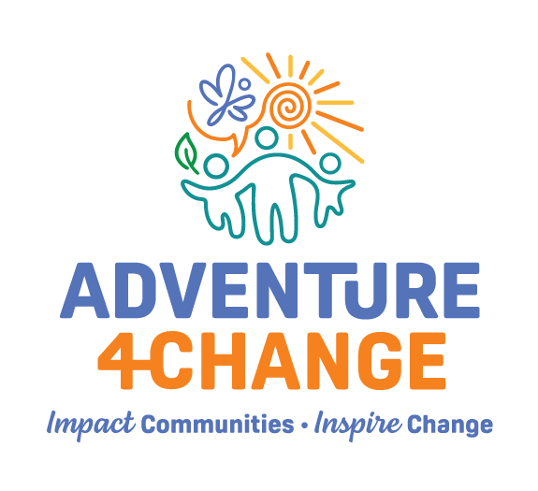
Looking Into
sWhat We Do At s

Slide 2
About
ADVENTURE4CHANGE
Key Points
Adventure4Change, a non-profit charity organization in North Waterloo.
We support newcomers, low-income families and refugees who come from various countries, and cultural backgrounds.
We run over 22 programs for kids, youth and families
Engaged with 80 families, 200 youth and 150 kids
Mission:
Contribute to children youth and their families. Realizing their unique potential to create impactful change
Vision:
Change our world by inspiring people towards lives self worth,respect, opportunity and contribution.
Values:
We nurture growth by building trust that inspires connections and tailored care while ensuring inclusion and contribution
Notes:
Adventure4Change is a non-profit charity based in North Waterloo. We serve newcomers, low-income families, and refugees from diverse countries and cultures. Over the past year alone, we’ve served 442 people.
Our mission is to help children, youth, and their families realize their potential to create meaningful change. We believe in building trust, fostering connection, and ensuring inclusion. These aren’t just values on paper — they guide every interaction we have with families.
Our vision is to change our world by inspiring people towards lives self worth,respect, opportunity and contribution.
Tell a story about this that has impacted your life that is specific to the newcomer experience, and how this has highlighted other newcomer challenges in the waterloo region:

Slide 3

About
The System Navigation Partnership
Key Points
Partnership happened in January 2021
Goal of the program is to support families in their journeys, helping them to thrive, with the hopes that they can one day contribute to society and make impactful change.
Supporting new families that come to our community.
“It is not about people learning to navigate the system, but the system learning to navigate the needs of people.”
- Dr. Jill Stoddart,
Director of Research, Development, and Outcomes at Family & Children’s Services
Notes:
In January 2021, we launched System Navigation in partnership with other organizations. Our goal is to walk alongside families — not just helping them ‘get by’ but thrive and eventually contribute back to the community.
As Dr. Jill Stoddart one of our partners, and a key member of the initiation of the Resilience Project says, ‘It’s not about people learning to navigate the system — it’s about the system learning to navigate the needs of people.’

Slide 4
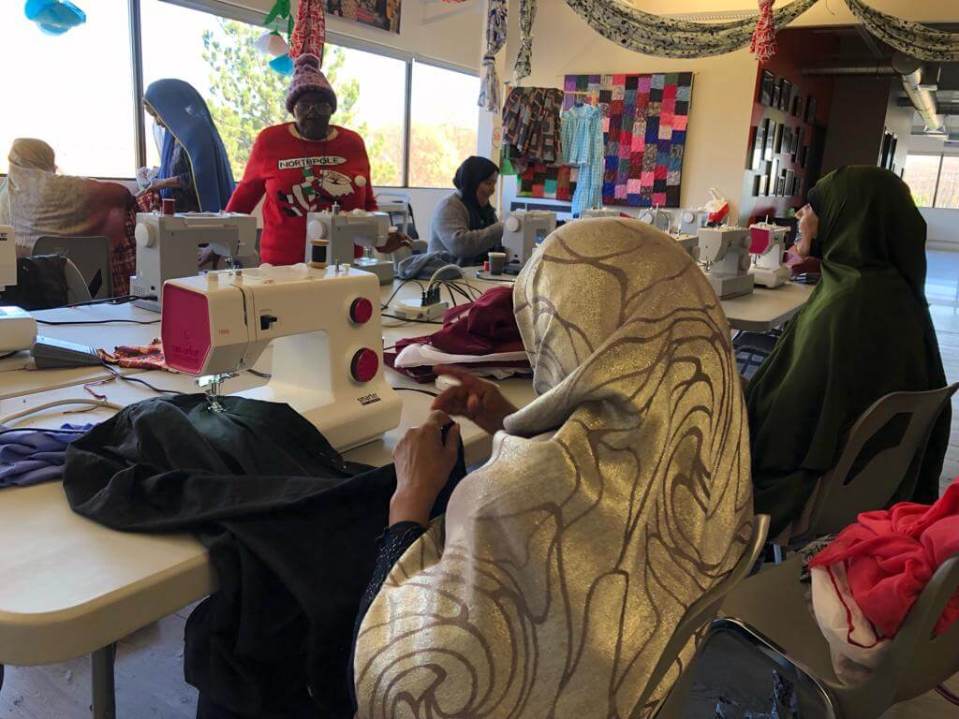
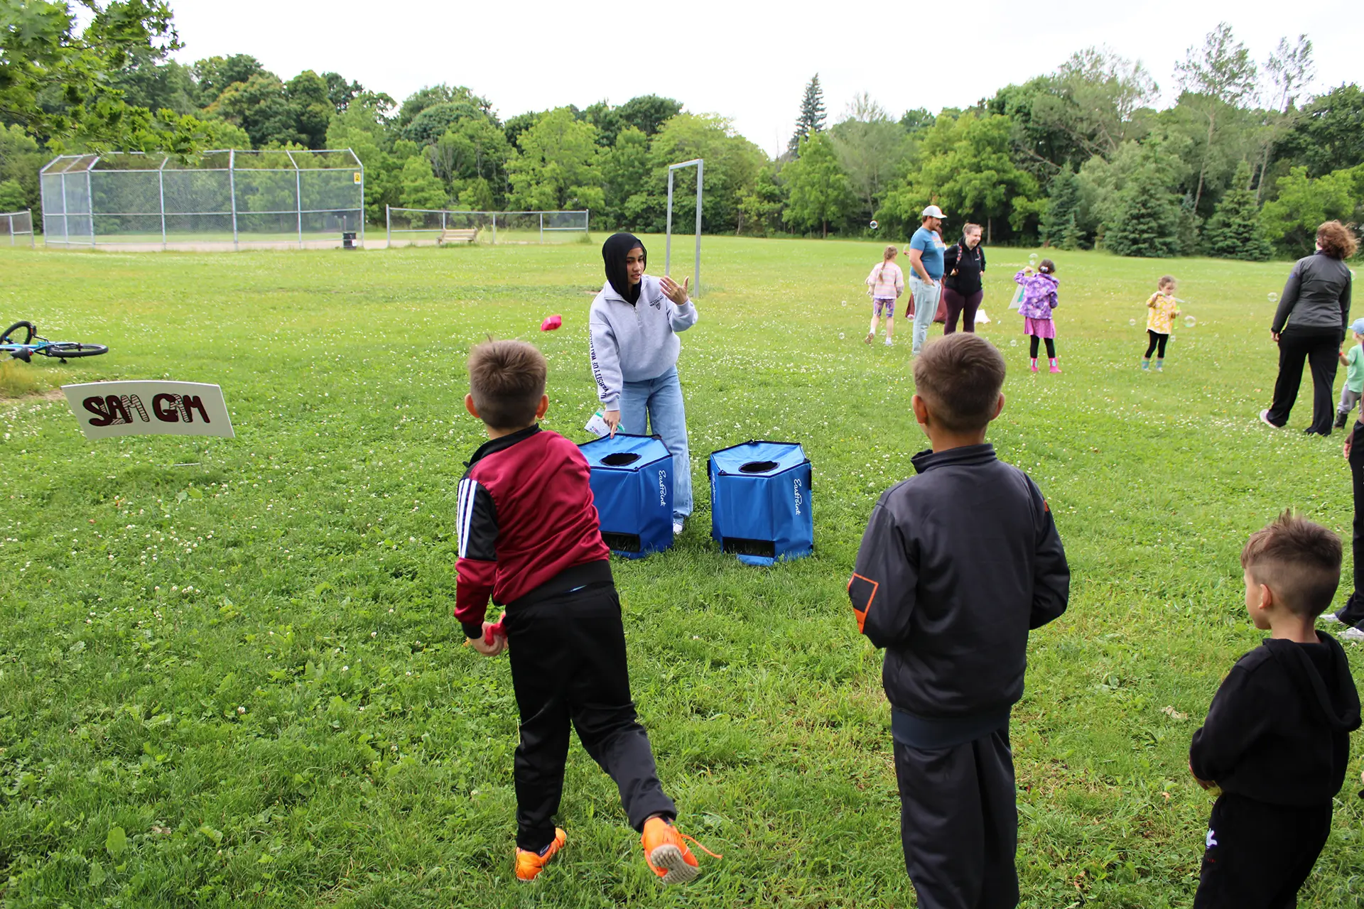
System Navigation
In Waterloo
Working mainly with black and racialized families:
Our families live primarily in Sunnydale, Albert Street and High Street
In 2024, we collected data on permanent residents in our community who use our resources consistently: 40 of our mums, 58 children and 102 youth are permanent residents
The families we support come from many different backgrounds which include Somalia, Ethiopia, Eritrea, Nigeria, South Sudan, Pakistan, Syria, Turkey and Iran
Notes:
From 2013 to 2022, over 42,000 permanent residents arrived in Waterloo Region. In 2024 alone, we welcomed 10,210 — a 5.31% increase from the year before.
Adventure4Change Data: In 2024, 40 mothers, 58 children, and 102 youth in our community regularly used our resources. In 2025 so far, we’ve supported 47 students weekly in tutoring, helped 17 families with housing, assisted 33 people with resumes and job applications, and provided legal support for 12 cases.
Talking Point: These aren’t just numbers — they represent families finding stability and hope through community connection.”*

Slide 5
System Navigation
In Waterloo
Main Ethnicities
Afar 1,405 (included in Somali) -
80 in our community
Somali 1,405 (0.2% of Waterloo Region)
112 in our community
Arab 9,535 (1.6% of Waterloo Region)
35 in our community
Notes:
Our community members are represented in less than 10% of the Waterloo Region, but the we have a lot of the people around us who represent these groups

Slide 6
System Navigation
In Waterloo
In 2025 alone:
Education - 23 cases
47 Students weekly in tutoring
Housing - 17 families
Resume - 33 people with resume writing, and job application
Court System
11 individual cases
1 Tenant Community Case
Partnership with
Waterloo Region Community Legal Services (WRCLS)
Eviction Prevention (Social development centre)
Notes:
Over the past year we have been able to support our community members through
|Education - 23 cases
47 Students weekly in tutoring
Housing - 17 families
Resume - 33 people with resume writing, and job application
Court System
11 individual cases
1 Tenant Community Case
Partnership with
Waterloo Region Community Legal Services (WRCLS)
Eviction Prevention (Social development centre)

Slide 7
Sustaining
System Navigation
We have a high demand, but only with a small percentage of the newcomer population
Utilize the resources that are available in community organizations
Support the work they are doing by being involved as a participant or volunteer
Majority Community Workers in the Waterloo Region are Immigrants
Continue to advocate for your needs
The City is expanding, and considers all the people coming into it, but community organizations are vital for belonging and developing a sense of resource allocation
Notes:
The need is high, but resources are limited.
Talking Point: To truly support newcomers, we need to strengthen the organizations that form the backbone of community integration. These groups are not ‘extras’ — they are essential to creating belonging in our growing city.
System Navigation is about more than guiding people through bureaucracy — it’s about building a community where everyone feels they belong, are empowered, and have the tools to succeed.
When we stand beside newcomers, we help them not just live here — but truly call Waterloo Region home.

Slide 8

Kids Club
Kids Tutoring
Minds in Bloom
Camp
OUR
Kids’ Programs
Notes:
When newcomers arrive, they face multiple systems at once — the court system, education, employment, housing — often while navigating a new language.
Talking Point: This isn’t just about ‘adjusting to life in Canada.’ It’s about doing it while dealing with urgent needs like finding safe housing or enrolling children in school — all while learning how everything works.”
I will break this down point my point

Slide 9
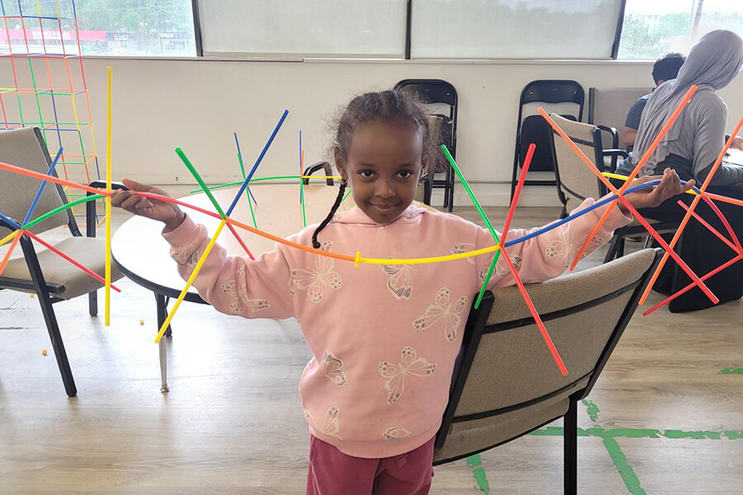
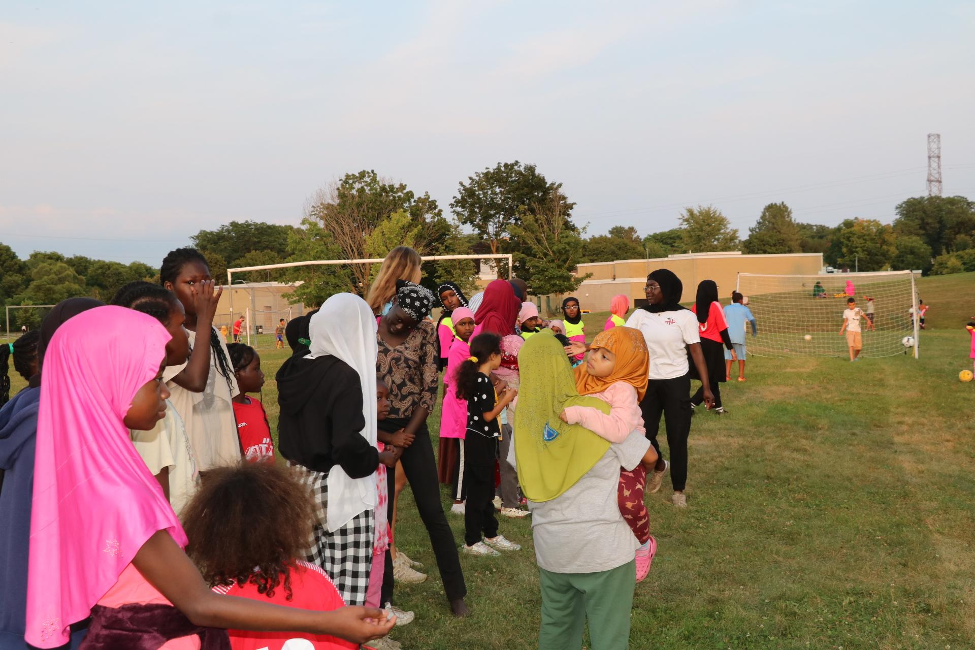
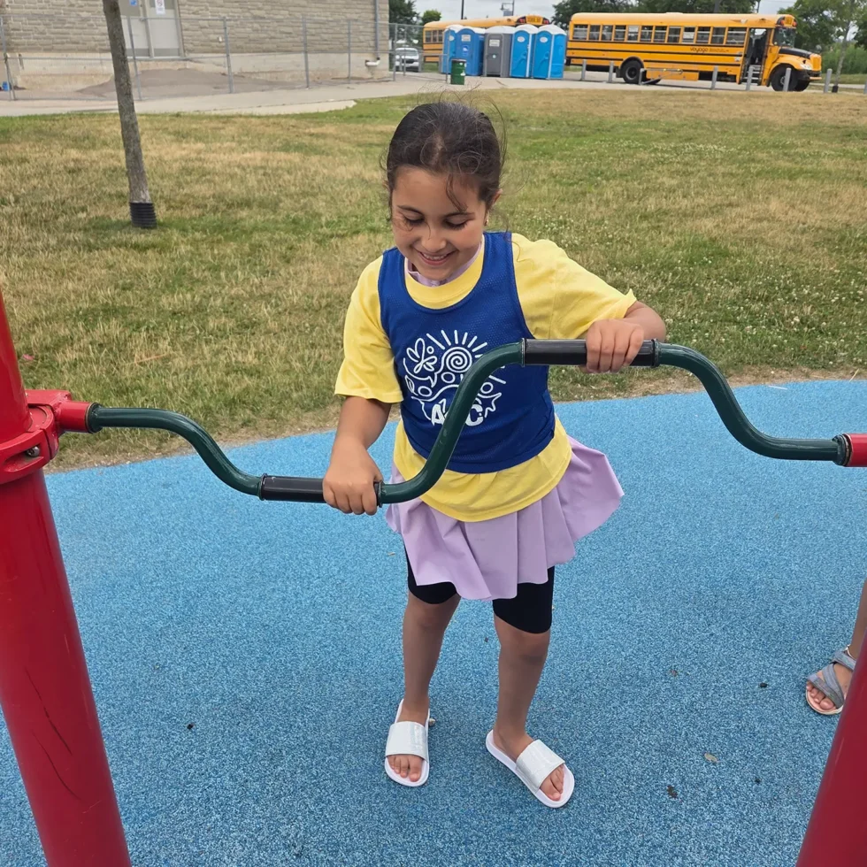
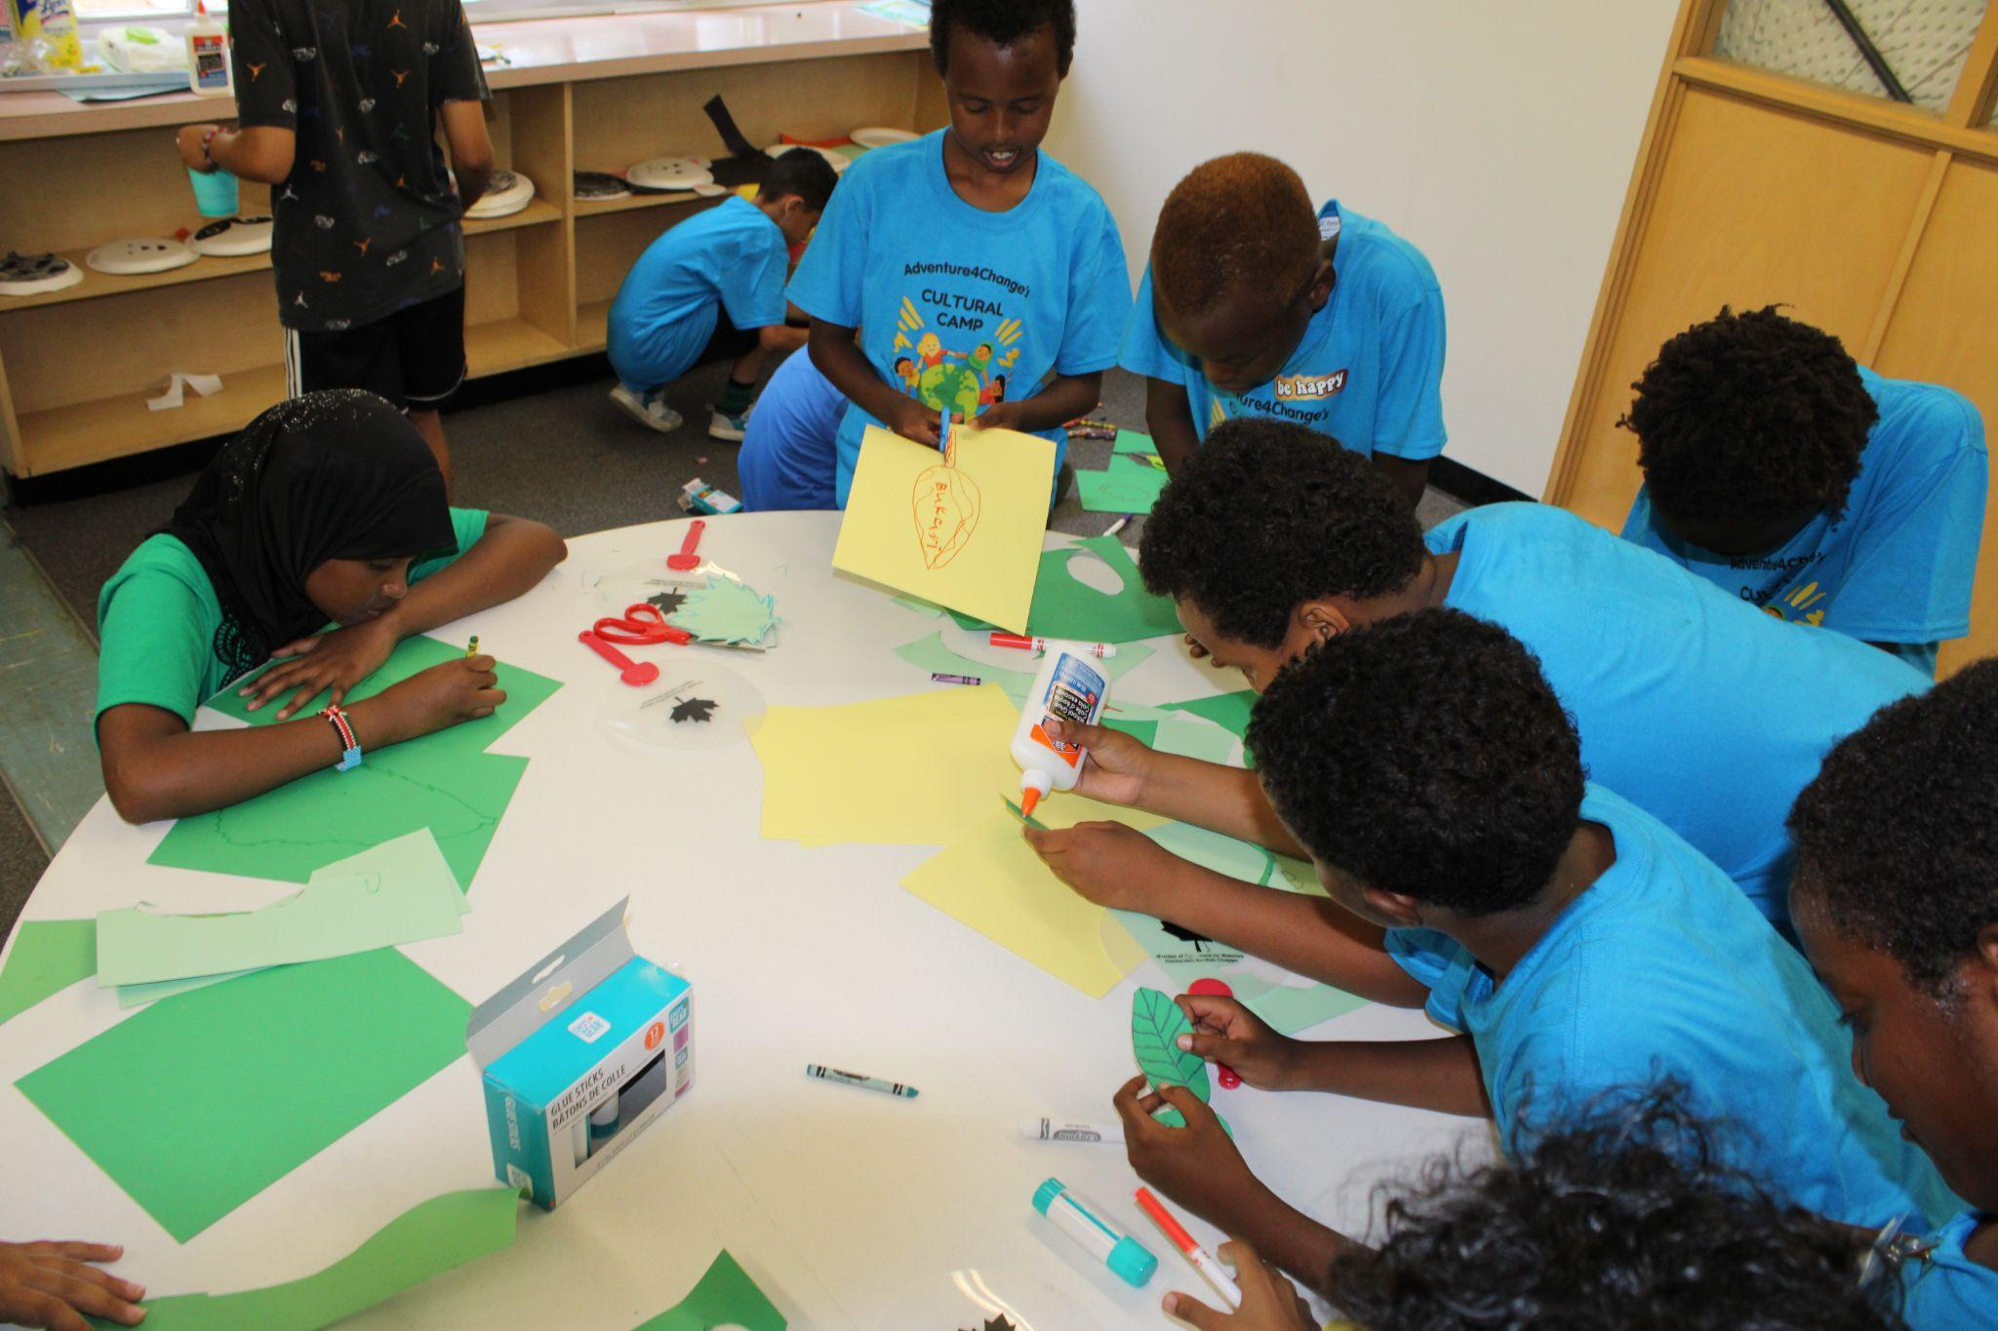
Notes:
When newcomers arrive, they face multiple systems at once — the court system, education, employment, housing — often while navigating a new language.
Talking Point: This isn’t just about ‘adjusting to life in Canada.’ It’s about doing it while dealing with urgent needs like finding safe housing or enrolling children in school — all while learning how everything works.”
I will break this down point my point

Slide 10
Moms Sewing
Festival
Focus Groups
Coffee & Conversation
OUR
Family Programs
Notes:
When newcomers arrive, they face multiple systems at once — the court system, education, employment, housing — often while navigating a new language.
Talking Point: This isn’t just about ‘adjusting to life in Canada.’ It’s about doing it while dealing with urgent needs like finding safe housing or enrolling children in school — all while learning how everything works.”
I will break this down point my point

Slide 11
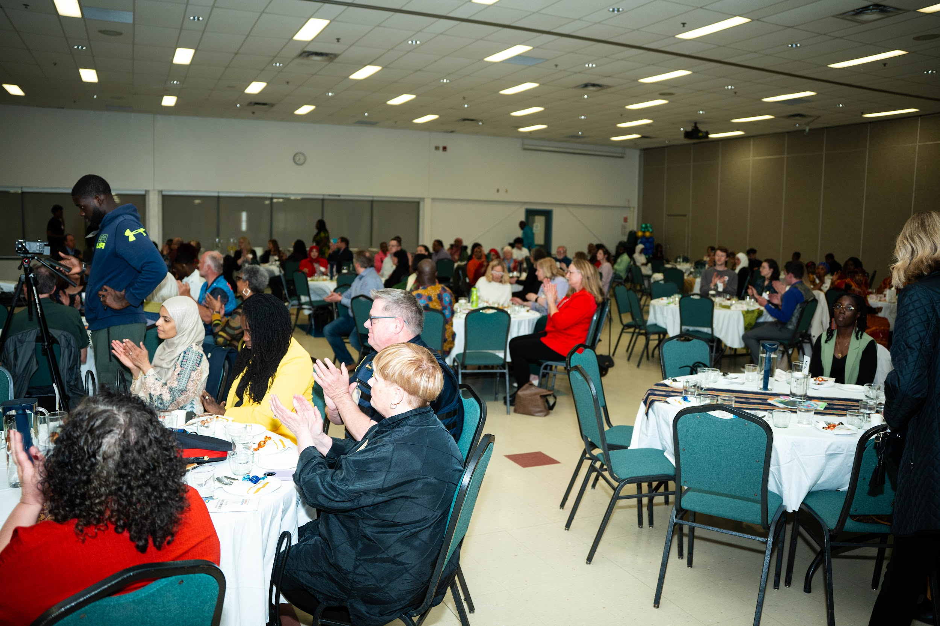
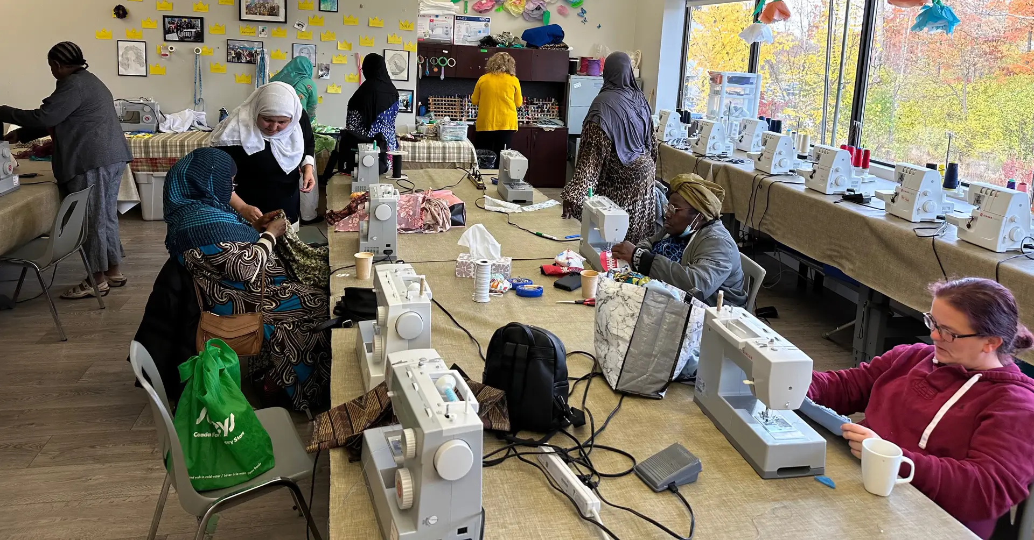
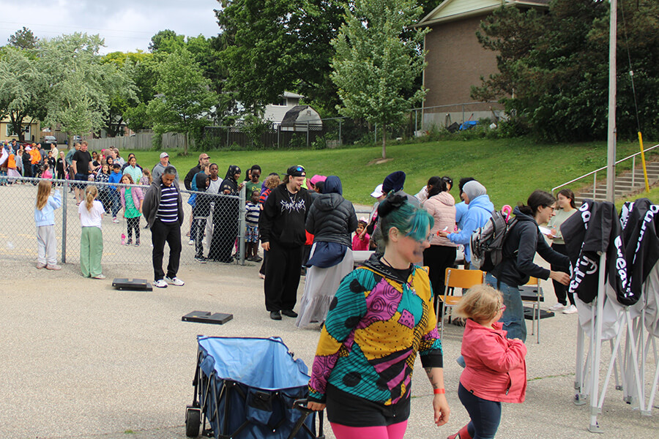
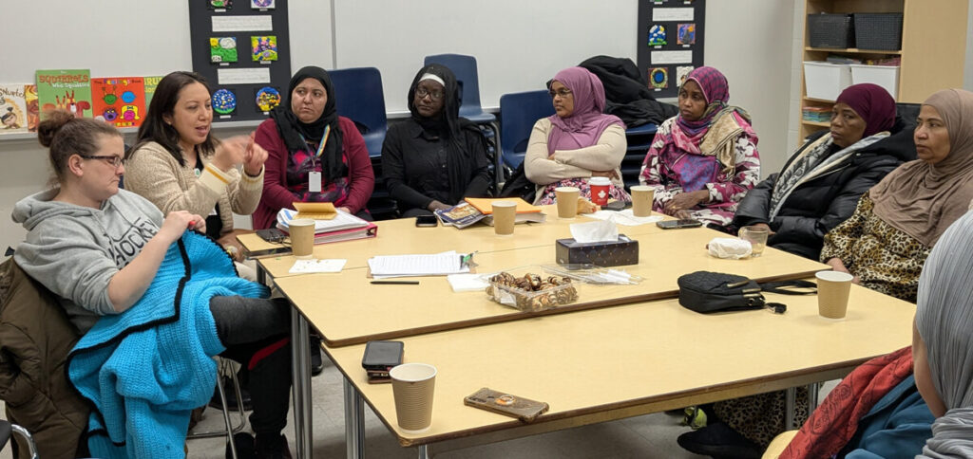
Notes:
When newcomers arrive, they face multiple systems at once — the court system, education, employment, housing — often while navigating a new language.
Talking Point: This isn’t just about ‘adjusting to life in Canada.’ It’s about doing it while dealing with urgent needs like finding safe housing or enrolling children in school — all while learning how everything works.”
I will break this down point my point

Slide 12
Soccer
Basketball
Girls Sports & Fitness
Tutoring
Leadership Trips
Connect - Youth Group
Young Queens - BIPOC Girls Youth Group
BSU
OUR
Youth Programs
Notes:
When newcomers arrive, they face multiple systems at once — the court system, education, employment, housing — often while navigating a new language.
Talking Point: This isn’t just about ‘adjusting to life in Canada.’ It’s about doing it while dealing with urgent needs like finding safe housing or enrolling children in school — all while learning how everything works.”
I will break this down point my point

Slide 13
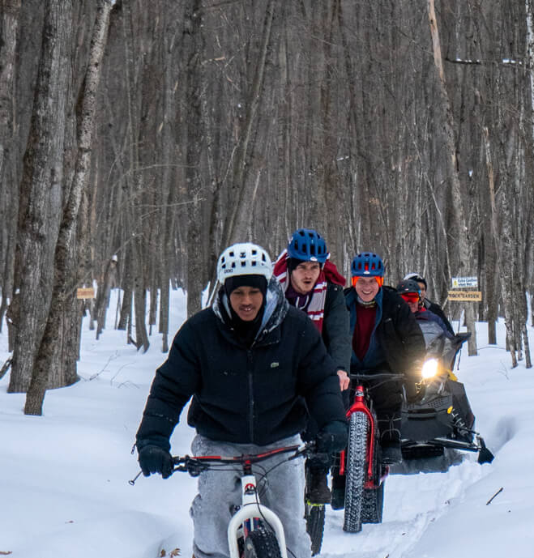
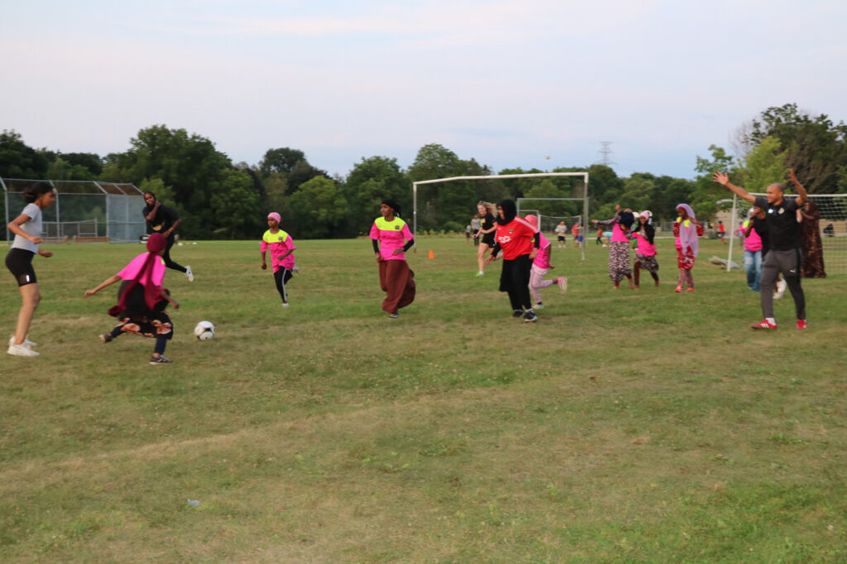
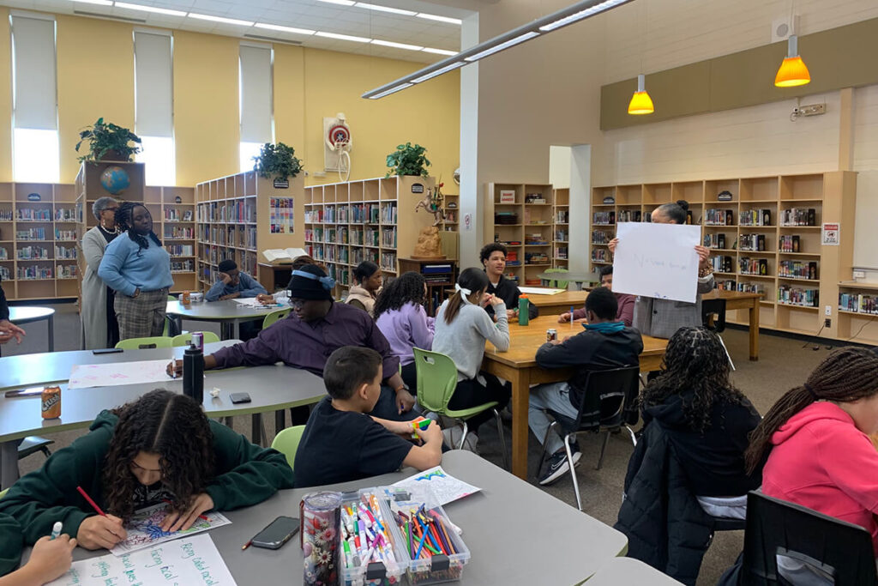
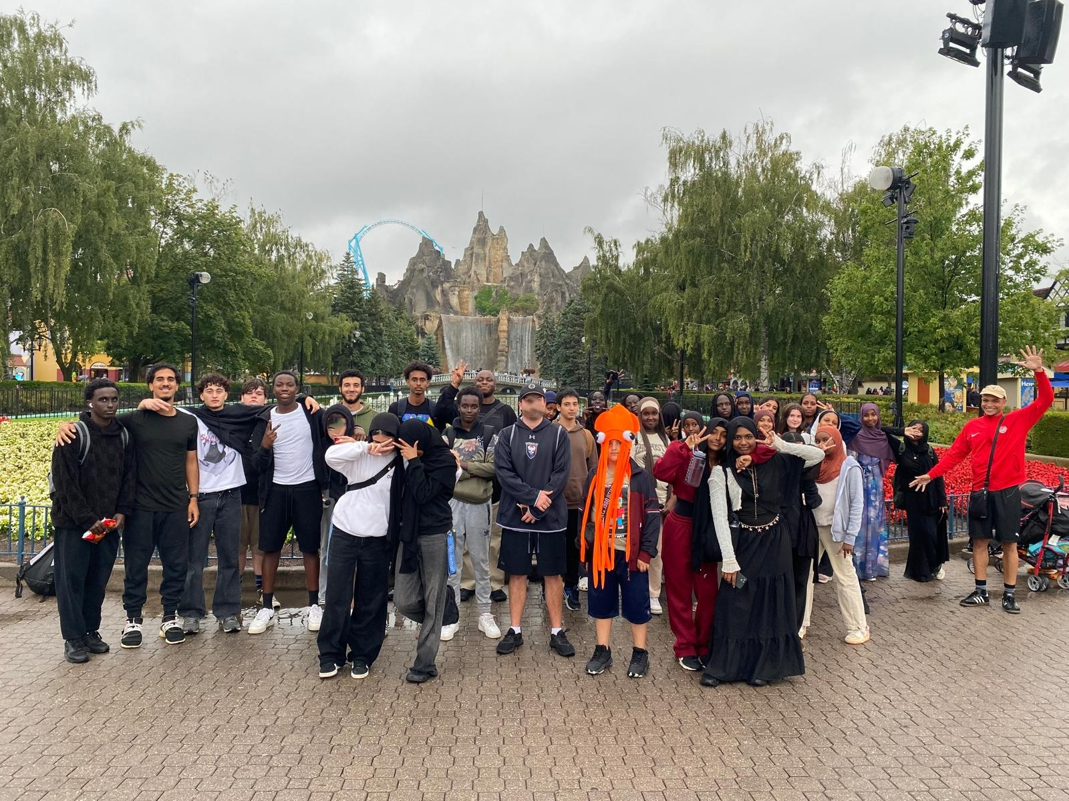
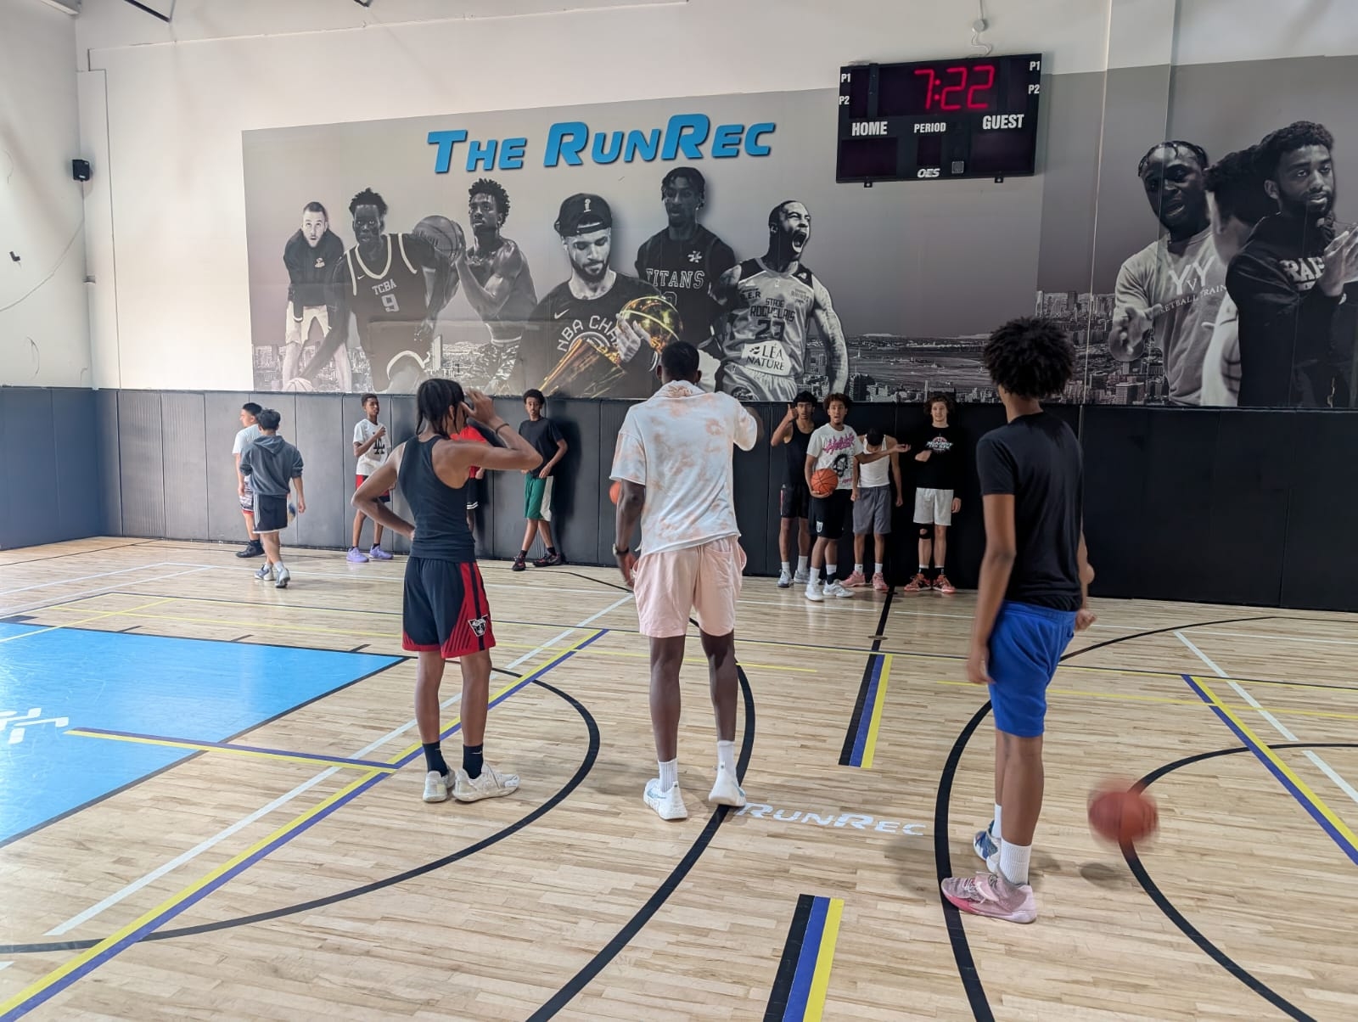
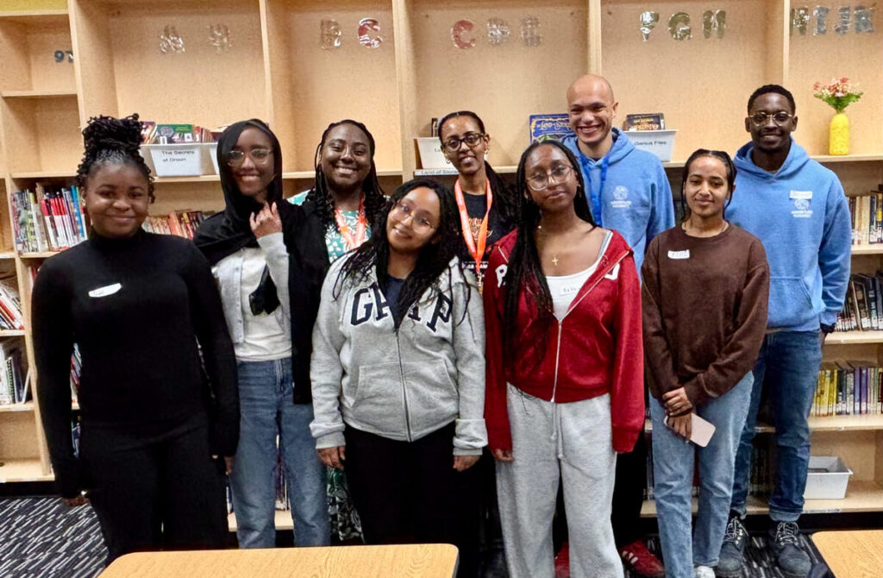
Notes:
When newcomers arrive, they face multiple systems at once — the court system, education, employment, housing — often while navigating a new language.
Talking Point: This isn’t just about ‘adjusting to life in Canada.’ It’s about doing it while dealing with urgent needs like finding safe housing or enrolling children in school — all while learning how everything works.”
I will break this down point my point

Slide 14
Importance of
Community
Belonging and Safety
Cultural Education
Representation
BSUs
Notes:
When newcomers arrive, they face multiple systems at once — the court system, education, employment, housing — often while navigating a new language.
Talking Point: This isn’t just about ‘adjusting to life in Canada.’ It’s about doing it while dealing with urgent needs like finding safe housing or enrolling children in school — all while learning how everything works.”
I will break this down point my point

Slide 15
That’s some stuff about
sAbout Uss

