Slide 1

What does the Future Hold?
Bennett MacDonald
January 28,2026

Slide 2

It looks scary…
Multiple jobs and careers
Skilled trades in demand
Lifelong learning needed
Can we work from home?
Global disruption
???????
Robots and AI and Automation… oh my!
Jobs will disappear or shift
Shorter work weeks? Same # of hours?
Notes:
Skilled trades- even in our current environment there is demand – just not in the “well-known ones” and we’ll talk about that
Multiple jobs – no one is staying on one path now. In fact, rarely have we ever unless we were a professional and even then, they are shifting, developing so reframe from what do I want to do to what is the first thing I want to do
WFH – some industries will be able to do this (project based) and some won’t (products, in-person clients). At the same time, there is a call back to office spaces happening so the flexibility of COVID may not remain
AI/automation- we are in a technological tools shift where the skills needed to interact effectively with AI are not taught – like how to ask a question to get an appropriate answer, how to identify misinformation/misquotes and analyze what is produced – AND we’re not sure of the legal and ethical parts of AI and automation like who owns what, what if AI hallucinates a quote from a professional – who gets sued for any damages
Global disruption – there is a lot of aggression in the world right now that may be generational in its effects – we’ve seen responses like Canada’s and the EU’s agreements – major agreements signed that cut out traditional partners but are bringing different types of industries like defense, aero and energy sector to Canada and locally
Work weeks – what does this look like? We’ve seen examples globally of how the companies have introduced 4 day work weeks. If Ai can do some of the work, then is that a reality? What does pay look like?
Jobs disappearing and shifting – Jobs are going to change. They always do and skills will change. The jobs that could exist 10 years from now don’t exist today or they will have shifted dramatically
Lifelong learning – everything we have discussed all leads us to one place. You need to be a learner, an adapter. And traditional education is not your only solution. It may be your foundation but as you move forward it will be learning where and how you can (any examples you have like the social media training you took to show that so many places to learn
Finally, we have no idea what is coming at us – another pandemic? All out war? Who knows

Slide 3

But what do any of these things mean for high schoolers trying to figure out their future? And for the parents trying to help them?

Slide 4

Work seemed straightforward in the past

Slide 5
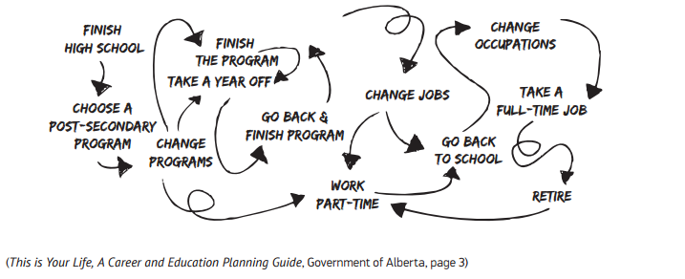
When it really looks and feels more chaotic…
Notes:
Any personal experience you want to share is welcomed as I know you’re not exactly where you thought you’d land and you’ve done some side gigs and skill built

Slide 6

What does the landscape look like now with employment?

Slide 7

Unemployment Rate: Most Reported Stat
Source: Statistics Canada. Labour Force Survey. Tables 14-10-0458-01 and 14-10-0462-01.
Notes:
This is the one you probably have all heard
Let me break down what it is and is not – is anyone part of the labour force who is currently unemployed
Youth 15 to 19 (which would be our high school grads going to the workplace)
October’s rate was 27.2% - 23.7% for men+ and 31% for women+

Slide 8
How is Employment Going?
Source: Statistics Canada. Labour Force Survey. Tables 14-10-0458-01 and 14-10-0462-01.
Notes:
This is a lesser known one by community
Here is what it is and does include everyone 15+ even in school – so includes more than the labour force
Youth 15 to 19 (which would be our high school grads going to the workplace)
October’s rate was 31.4% - 34.1% for men+ and 28.7% for women+

Slide 9
How many of us 15+ are participating?
Source: Statistics Canada. Labour Force Survey. Tables 14-10-0458-01 and 14-10-0462-01.
Notes:
Define participation everyone who is actively working or looking for work (not retirees, not students) – this is quickly becoming the rate we’re really watching and is the reference number we need to put those other 2 numbers in context
As of December 2025, K-W-C has the 2nd highest participation rate in the country just behind saskatoon.
Youth 15 to 19
October rate was 43.2% - 44.7% for men+ and 41.6% for women+

Slide 10
Anticipated Local Growth
Industries
Nuclear
Automation
Aerospace
Industries that feed into the Nation Building projects
Manufacturing
Caring Sector
Start-up potential to grow
Occupations
Engineers and engineering techs (mechanical, electrical, mechatronics, nuclear, software**)
Programmers (virtual environments)
Skilled Trades (millwright, electrician, tool and die, MBTI, carpenters, aircraft and aviation trades)
Frontline caring services staff (ECE, CYW, DSW, PSW, SSW)
Notes:
Nuclear – Waterloo is 2 hours from 2 nuclear hot spots: Bruce and Darlington and we are a provider and servicer where nuclear is seen as a clean source of power. Smal modular nuclear reactors are bring built to power AI data centres across Europe and the US– we are a provider of machines to that industry and have a cluster of companies working in this sector in Cambridge
Automation – this aligns a lot with the nuclear industry as again, it is Cambridge centred growth. Most automation companies are expanding into Life sciences and Nuclear
Aerospace – Waterloo Region focus with the lands out by the airport – defense spending will rise. Partners are talking about building here and there will be companies that are providing parts and services to ths growth
Nation-building – there are generational investments being made cross-Canada and that supply chain into those industries will be huge. Mammoet (company specializing in moving big things like windmill blades, pieces for nuclear facilities will need people just as much as the industries being built)
Manufacturing is not dead – in fact in Waterloo Region, transportation equipment manufacturing employment did not see the losses that Windsor or our neighbours Guelph saw. Toyota’s long-term vision was a major part of that. EV is the buzzword but hydrogen will be the future
Caring Sector – aging population, changing habits and needs of people will mean we still need people. Hospital build will dramatically increase how many people work in health care. And services are changing meaning the roles will need to change because people’s needs are more complex whether that is education, child care, mental health or housing supports.
Start-ups: we cannot forget our tech – start-ups grow into bigger companies and there will be that need as we have a very supportive environment in the Region to help grow companies

Slide 11
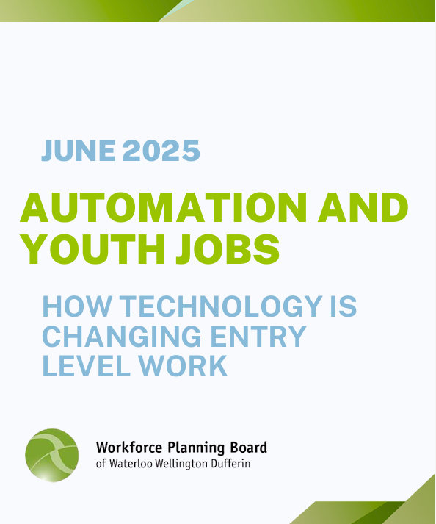
** About that AI, robotics, automation thing…
Repetitive skills will disappear to be replaced with different roles or let people focus on different parts of their work: strategy, people, analysis
Least disruption to people and empathy-based roles
Many future jobs involve data, robotics, AI, information security, software development, programming, database and network professionals, mechanics, machinery repair
Skills needed as AI expands: Problem solving, Critical thinking, Fact identification, Pattern recognition, People skills, Data management, Prompt development (how to ask questions)

Slide 12
Skilled Trades: The Info You Need
144 trades in Ontario
4 areas: Industrial, Construction, Service and Motive Power
23 of them are compulsory (Register and do an apprenticeship)
Often takes 2-4 years of experience to complete an apprenticeship along with education
The knowledge to do many of these trades is offered through college diplomas.
A reframe: Many of these careers are postsecondary STEM careers (need math, physics, chemistry, technical knowledge) that are for people who also like to work with their hands.
And they can pay well – pay varies by trade and what you decide to do with it

Slide 13
Skilled Trades: The Info You Need
These careers have impact in people’s lives
Carpenters, plumbers and electricians will build the 64,000 housing units across southwestern rural parts of the province.
HVAC fix furnaces and air conditioners that keep our elderly and children from freezing or overheating.
Mechanics fix vehicles that take us to the cottage and to work, deliver our Amazon purchases, harvest our food, fly us to foreign destinations, mine critical minerals.
Hairstylists and barbers make sure our most special moments are close to picture perfect
Child development practitioners, child and youth worker and developmental service workers care for our loved ones everyday.
Notes:
I always talk about impact here because often people want gratification/ a tangible to come out of what they have done so I gave some examples of where tradespeople touch our lives and derive satisfaction

Slide 14
Skills and Learning Needed
Some of these jobs that will be in-demand don’t even exist yet.
Different lists out there give the top skills so picked some commonalities
Digital literacy
Emotional intelligence
Creative and innovative mindset
Critical thinking
Data literacy
Continuous learning/Growth mindset
Independent
Communication
Notes:
Digital literacy: analyze what you see, work with software/programs, social media analysis and marketing
Emotional intelligence: empathy, interpersonal skills, work with people, recognize bias in self and others, manage
Creative and innovative mindset: flexibility, see potential for what could be, problem solve
Critical thinking: recognize misinformation, problem solve, pull together different info from different sources,
Data literacy: process the information that exists to see trends, gaps, faults and use it to make decisions
Continuous learning/Growth mindset: be willing to learn new things and grow your skills
Independent: work on own, meet deadlines
Communication: written skills that are clear and concise (not flowery, overly detailed, academic), cross-cultural communication (identify and remove idioms that limit understanding), persuasion, negotiation, AI prompt generation, active listening

Slide 15

Notes:
What is on FYJ - tools, assets for students – fpcus on Career Library for this group probably.

Slide 16

Questions?

